Slide 1

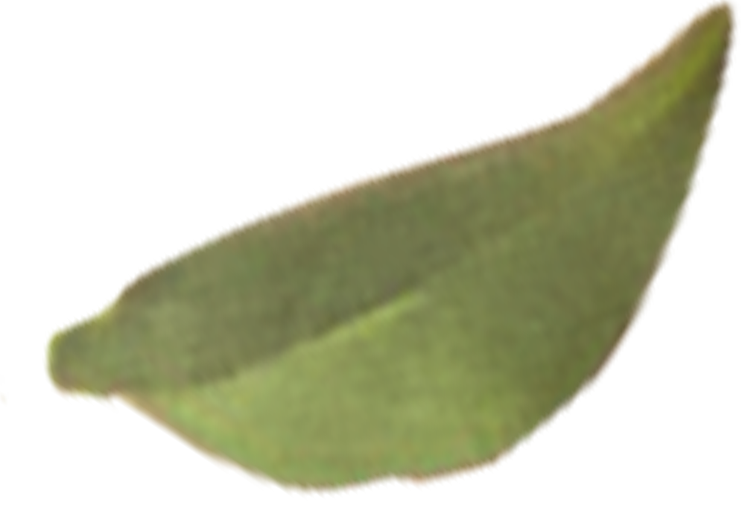

Project Name: Seasonal Agriculture Performance Analysis
NAME: MRUNALI SAYAJI MINDE
AICTE ID : STU6a633feae3b6b1784889322

Slide 2
Introduction to Dataset
The dataset represents agricultural activities carried out across different seasons, geographical areas and farming conditions. It contains information related to farming practices, environmental conditions, crop production, resource usage and economic performance.
The dataset provides students with an opportunity to explore how agricultural performance changes across seasons and to identify meaningful patterns and differences through data analysis.

Slide 3
Problem Statement
Agricultural activities are influenced by seasonal variations in environmental conditions, farming practices, resource availability and marketconditions. As a result, agricultural performance may differ from one season to another.
However, raw agricultural data does not clearly explain how agricultural performance changes across seasons or what patterns can be observed in different seasonal conditions.
The problem is to analyze the given agricultural dataset and investigate seasonal differences in agricultural performance by identifying meaningful patterns, trends, relationships and
variations within the available data.

Slide 4

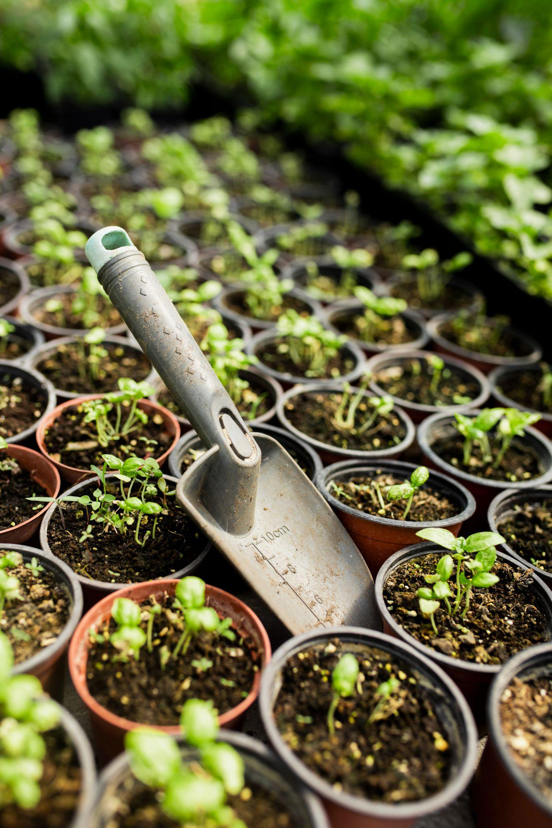
Importance of the Problem Statement
Seasonal variations can influence different aspects of agricultural activities and performance.
Understanding seasonal patterns through data analytics can help stakeholders:
Understand variations in agricultural performance
Identify important seasonal trends
Compare performance across different periods
Understand changing environmental conditions
Examine differences in resource usage
Identify areas requiring further investigation
Support evidence-based agricultural planning
For students, this problem provides an opportunity to work on a focused real-world Data Analytics problem rather than performing a generic analysis of the entire dataset.

Slide 5

Objective
The primary objective of this project is to analyze agricultural data from different seasons and identify meaningful patterns, trends, relationships and differences in agricultural performance.
Students should independently:
Explore and understand the dataset.
Clean and prepare the data for analysis.
Examine how agricultural performance varies across seasons.
Identify important seasonal patterns and trends.
Investigate relationships between seasonal conditions and agricultural outcomes.

Slide 6
Compare relevant groups within different seasons.
Identify significant differences or unusual patterns.
Apply appropriate statistical and visualization techniques.
Interpret findings based on evidence from the dataset.
Develop meaningful conclusions and data- driven recommendations.

Slide 7
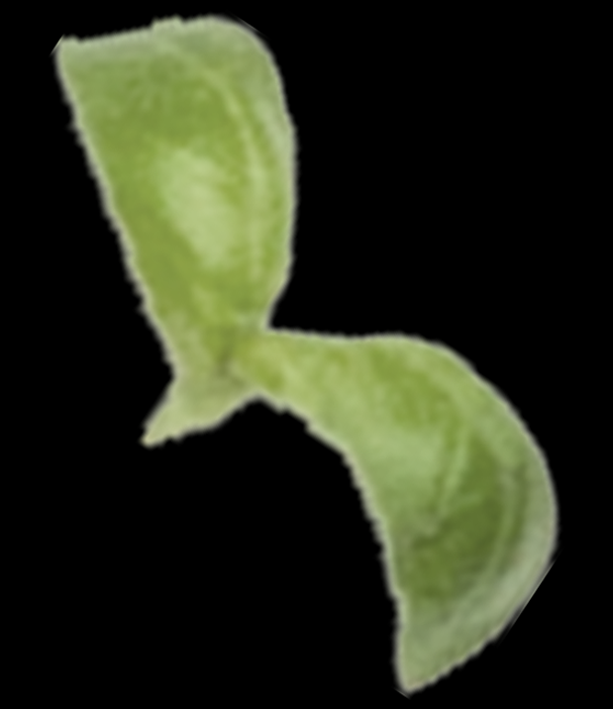
WHO ARE THE END USERS?
The Seasonal Agriculture Performance Analysis project can be useful for:
Farmers – To understand which seasons provide better yield, profitability, and resource efficiency.
Agricultural Planners – To support seasonal crop and resource planning.
Agricultural Researchers – To study relationships between environmental conditions and agricultural outcomes.
Government & Agriculture Departments – To support evidence-based agricultural policies and planning.
Agribusinesses – To understand production, costs, market performance, and seasonal opportunities.
Data Analysts – To identify seasonal trends, correlations, and unusual patterns in agricultural data.

Slide 8
Technology Used
c
For your Seasonal Agriculture Performance Analysis project, you can mention:
Python – Core programming language
Jupyter Notebook – Development and analysis environment
Pandas – Data cleaning, preprocessing, and analysis
NumPy – Numerical computations
Matplotlib – Data visualization
Seaborn – Statistical charts and visualizations
CSV – Dataset/input data format

Slide 9
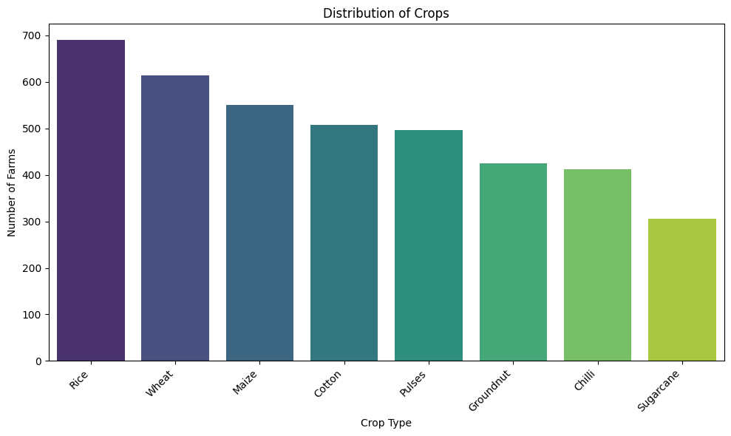
The “Distribution of Crops” bar chart shows the number of farms associated with different crop types.
Rice has the highest distribution, with approximately 690 farms, making it the most commonly cultivated crop.
Wheat follows with around 615 farms.
Maize has approximately 550 farms.
Cotton and Pulses have around 510 and 500 farms, respectively.
Groundnut accounts for approximately 425 farms.
Chilli has around 415 farms.
Sugarcane has the lowest distribution, with approximately 305 farms.
Overall, the chart indicates that Rice, Wheat, and Maize are the dominant crops in the dataset, while Sugarcane has the lowest representation. This distribution helps understand the relative prevalence of different crop types among the farms analyzed.

Slide 10
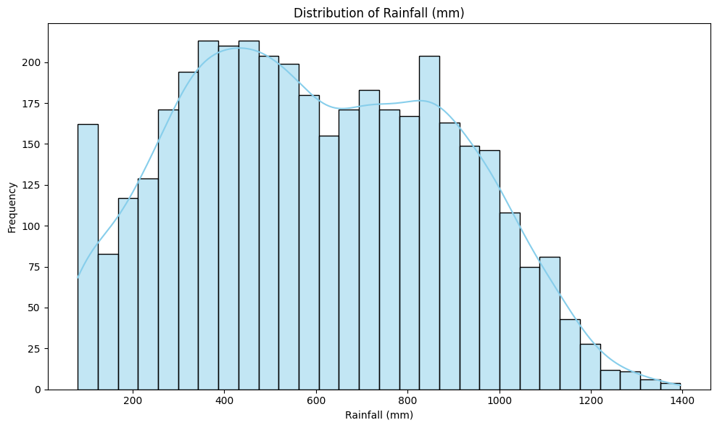
The “Distribution of Rainfall (mm)” histogram shows the frequency of different rainfall levels across the farms in the dataset.
Rainfall values range approximately from 80 mm to 1,400 mm.
The highest frequency of rainfall observations occurs between approximately 350 mm and 550 mm, indicating that moderate rainfall is most common.
There is another noticeable concentration around 700–900 mm, showing that a considerable number of farms experience higher rainfall levels.
Rainfall above 1,000 mm occurs less frequently, with the frequency gradually decreasing toward 1,400 mm.
The smooth density curve indicates that the distribution is not perfectly normal and has a right-skewed pattern, with a longer tail toward higher rainfall values.
Overall, most observations fall within the moderate rainfall range, while very high rainfall levels are comparatively less common.

Slide 11
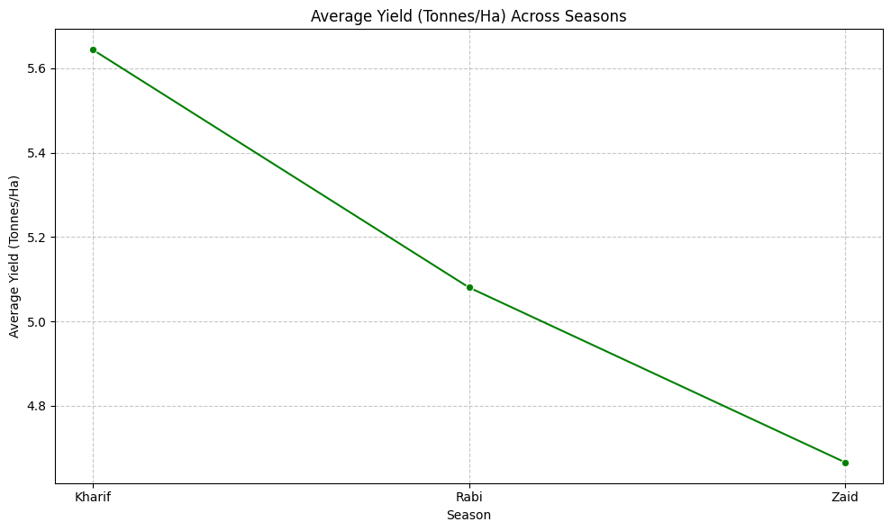
The chart compares the average agricultural yield across three seasons: Kharif, Rabi, and Zaid. Kharif records the highest average yield at approximately 5.65 tonnes/ha, followed by Rabi at 5.08 tonnes/ha. Zaid has the lowest average yield at around 4.67 tonnes/ha. Overall, the chart shows a gradual decline in average yield from Kharif to Zaid, indicating that seasonal conditions may influence crop productivity.

Slide 12
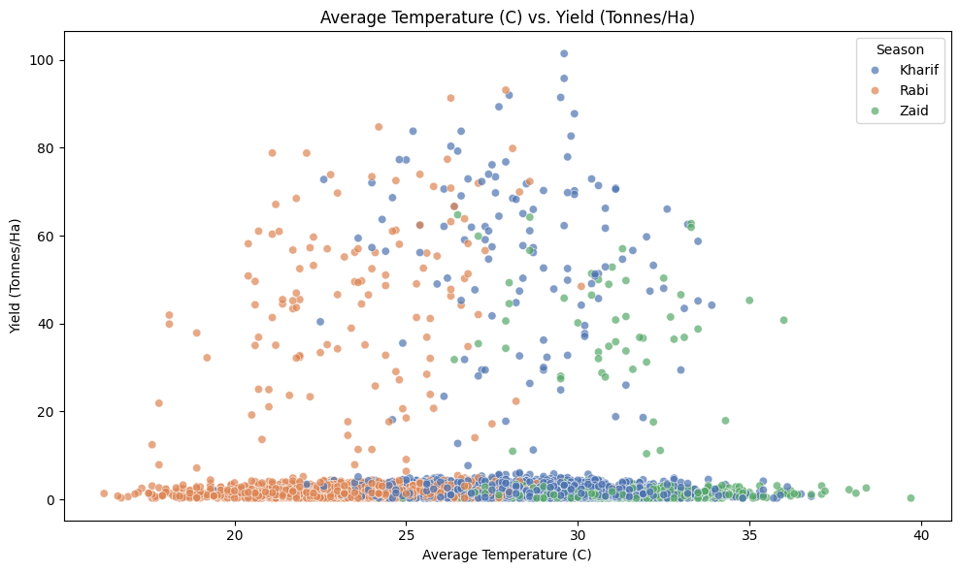
Description
The scatter plot shows the relationship between average temperature and crop yield across the Kharif, Rabi, and Zaid seasons. Most observations are concentrated at lower yield levels, while some farms show significantly higher yields. Kharif has several high-yield observations, reaching above 100 tonnes/ha, while Rabi and Zaid generally show lower maximum yields. Overall, the plot suggests that temperature alone does not have a clear direct relationship with yield, as yield varies considerably at similar temperature levels.

Slide 13
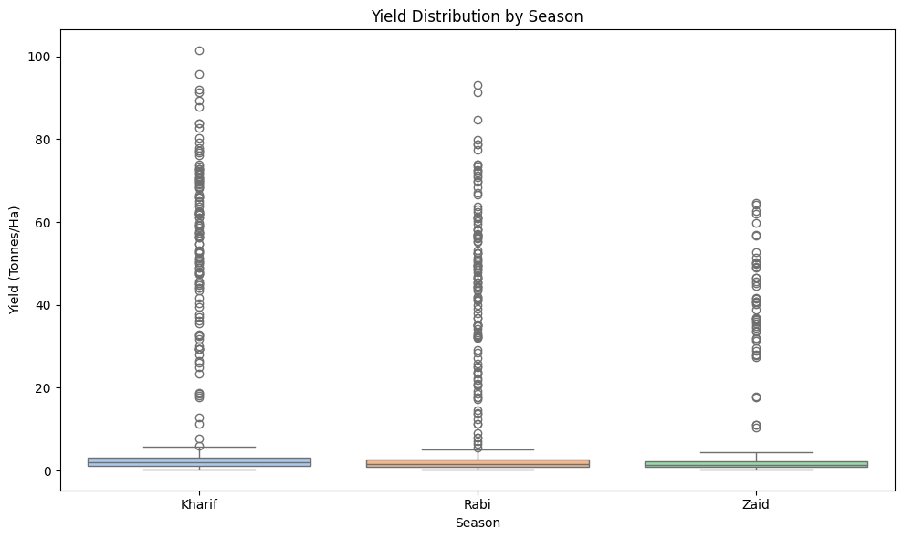
The box plot compares yield distribution across Kharif, Rabi, and Zaid seasons. The typical yield is relatively similar across all three seasons, but Kharif shows the highest variability and maximum yield values. Rabi also has several high-yield observations, while Zaid has a comparatively lower yield range. The large number of outliers indicates significant variation in crop productivity across farms.

Slide 14
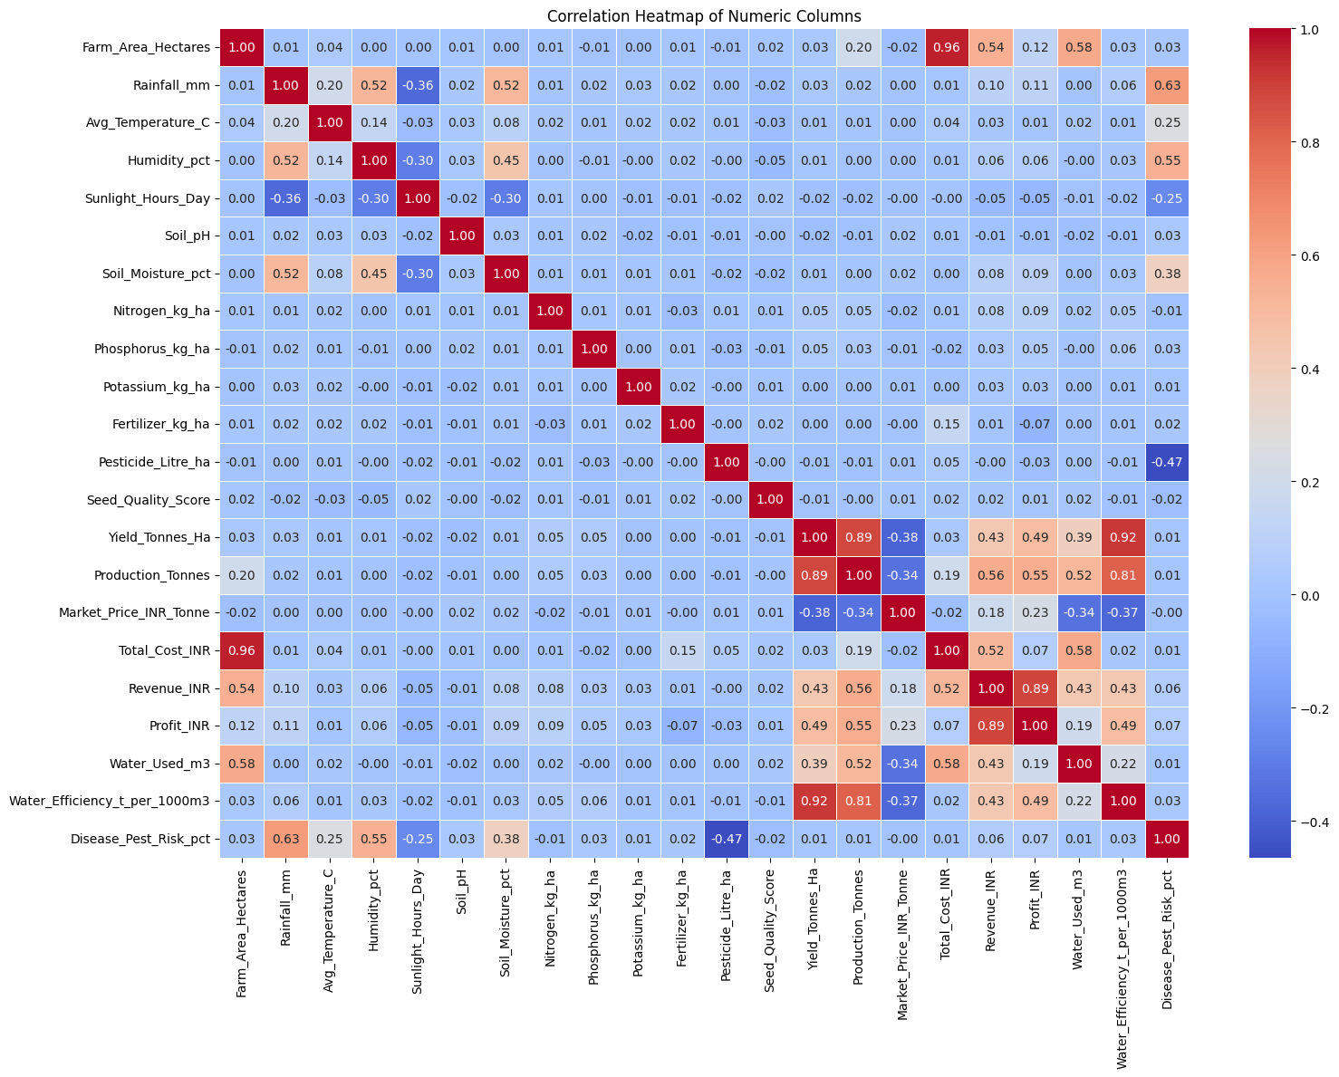

Slide 15
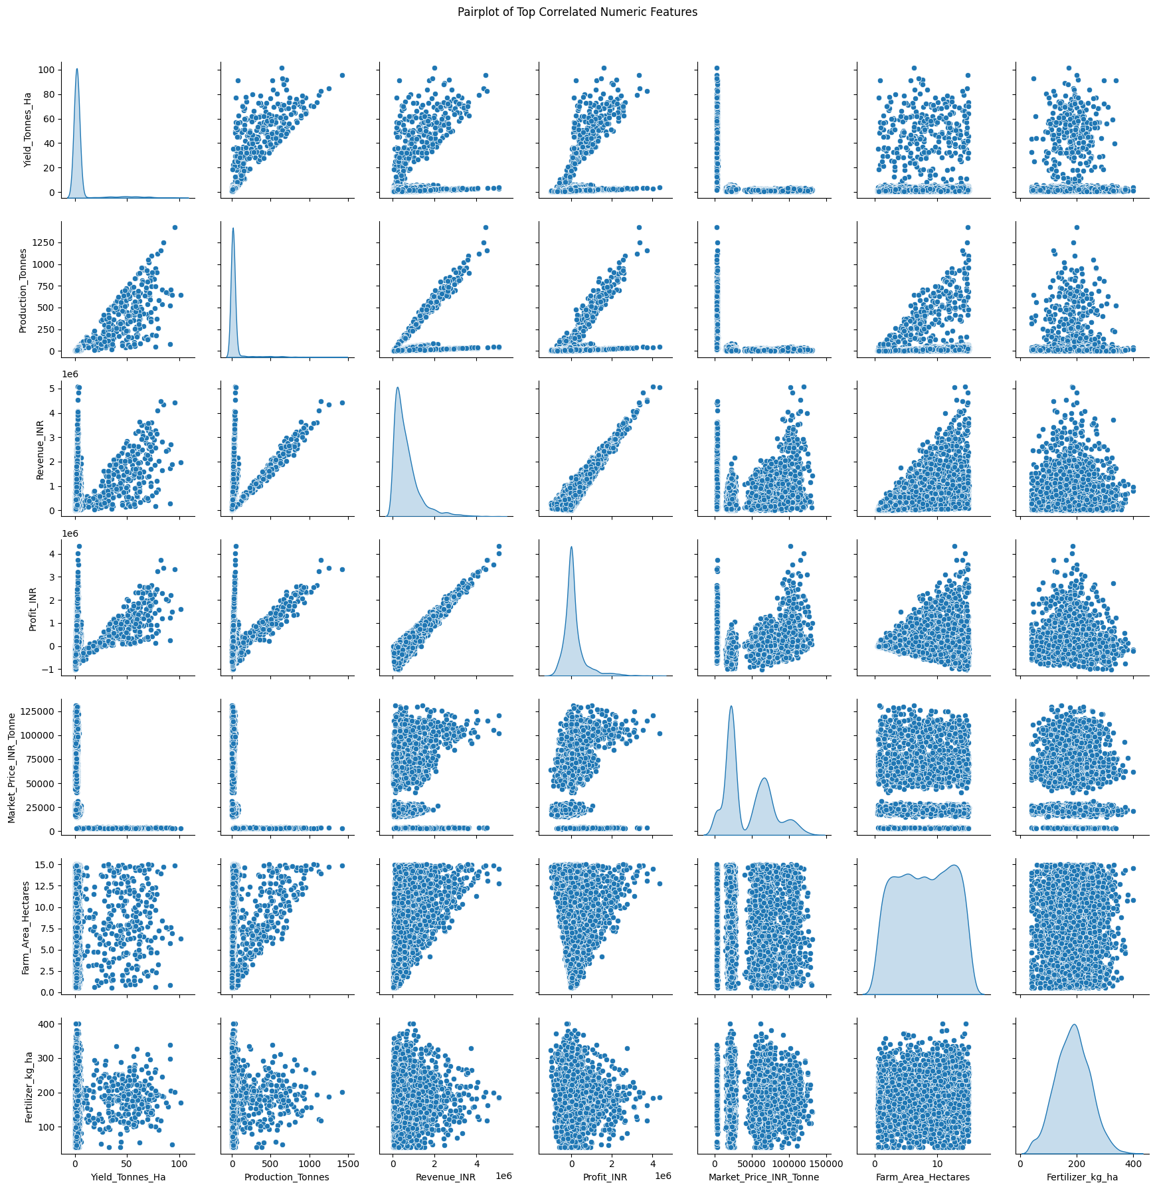
Description
The pairplot shows relationships among the top correlated numerical features in the agricultural dataset. It indicates a strong positive relationship between Yield, Production, Revenue, and Profit, meaning higher production and yield are generally associated with increased revenue and profit. Farm area and fertilizer usage also show noticeable relationships with these variables. The plots reveal some outliers and skewed distributions, which may represent farms with unusually high production, revenue, or yield. Overall, the pairplot highlights the key numerical factors that are closely associated with agricultural productivity and profitability.

Slide 16
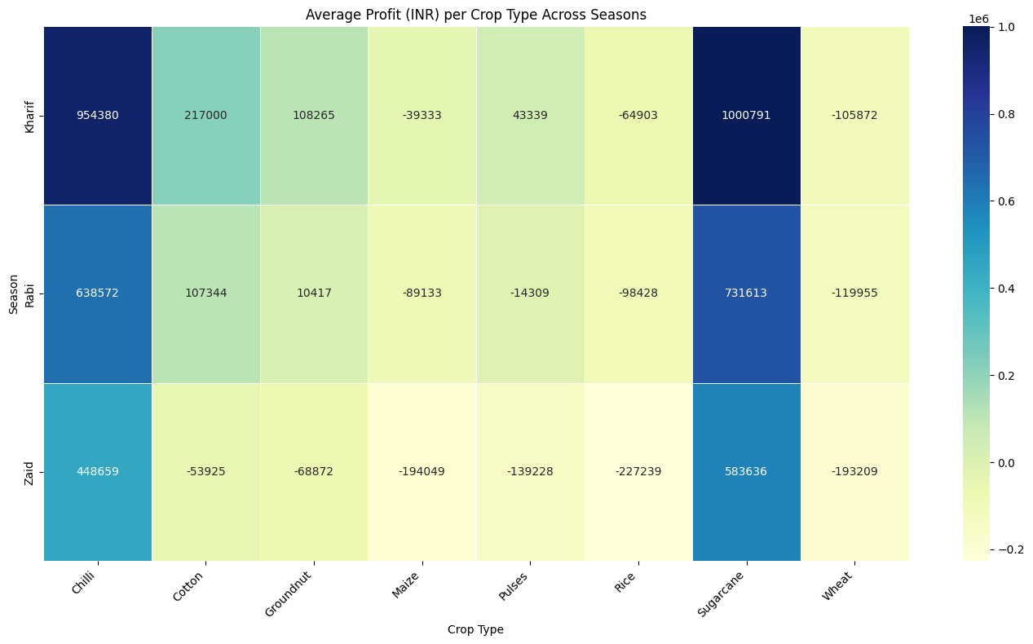
Sugarcane and Chilli are the most profitable crops ,especially in the Kharif season.
Kharif shows the highest overall profitability, while Zaid has the lowest.
Cotton and Groundnut are profitable mainly during Kharif but show losses in Zaid.
Maize, Rice, and Wheat record negative profits across all three seasons.
Overall, crop profitability varies significantly by season, with Kharif generally performing better than Rabi and Zaid.

Slide 17
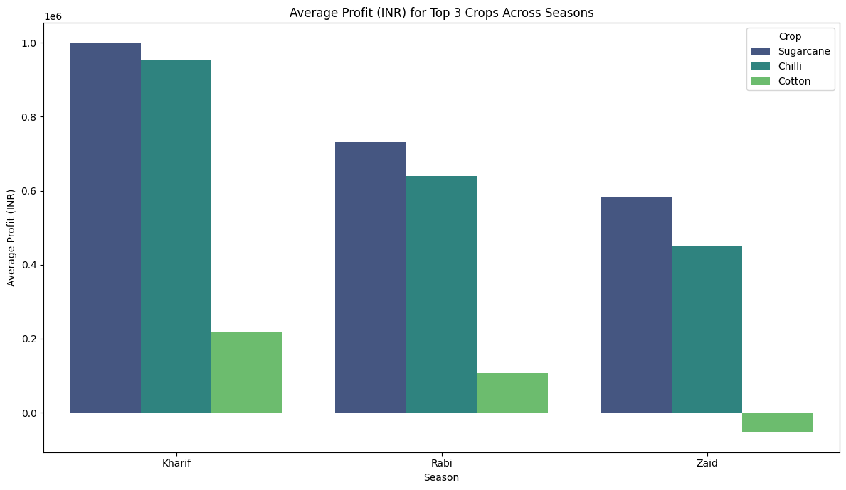
Sugarcane is the most profitable crop across all three seasons, with the highest profit in Kharif (~₹10 lakh).
Chilli ranks second, earning around ₹9.5 lakh in Kharif and ₹6.4 lakh in Rabi.
Cotton performs moderately in Kharif and Rabi but shows a loss in Zaid.
Kharif is the most profitable season for all three crops.
Overall, Sugarcane and Chilli show stronger and more consistent profitability than Cotton.

Slide 18
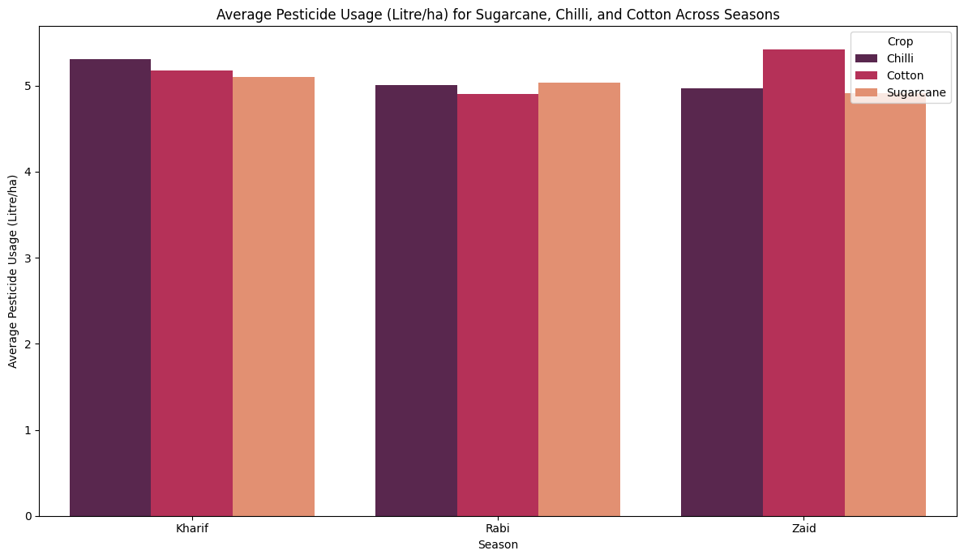
Chilli has the highest pesticide usage in Kharif (~5.3 L/ha).
Cotton shows the highest usage in Zaid (~5.4 L/ha).
Sugarcane maintains relatively consistent pesticide usage across all seasons, around 5.0–5.1 L/ha.
Rabi shows slightly lower pesticide usage for Chilli and Cotton compared with Kharif and Zaid.
Overall, pesticide usage remains fairly similar across the three crops and seasons, with only small variations.

Slide 19
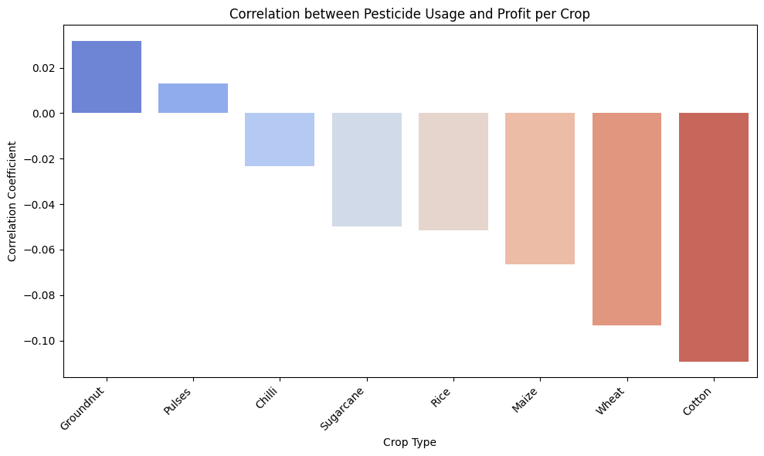
Groundnut and Pulses show a slightly positive correlation between pesticide usage and profit.
Chilli, Sugarcane, Rice, Maize, Wheat, and Cotton show a negative correlation.
Cotton has the strongest negative correlation, indicating that higher pesticide usage is weakly associated with lower profit.
Overall, the correlation values are close to zero, suggesting that pesticide usage has very little direct relationship with profit.
This indicates that factors such as yield, production, market price, rainfall, and input costs may have a greater influence on agricultural profitability.

Slide 20
Future Scope
The Seasonal Agriculture Performance Analysis project can be further enhanced in the following ways:
Crop Recommendation System – Develop a system that recommends suitable crops based on season, soil, rainfall, temperature, and other conditions.
Yield Prediction – Use Machine Learning models to predict crop yield for upcoming seasons.
Weather Integration – Integrate real-time weather data to improve seasonal agricultural analysis.
Real-Time Monitoring – Develop a dashboard to continuously monitor agricultural performance and environmental conditions.
Regional Analysis – Expand the analysis to more states, districts, and geographical regions.

Slide 21
Resource Optimization – Use predictive analytics to recommend efficient usage of water, fertilizers, and pesticides.
Profit Prediction – Predict expected revenue, cost, and profit based on crop and seasonal conditions.
Mobile/Web Application – Convert the analysis into a user-friendly application that farmers and agricultural planners can access easily.
AI-Based Decision Support – Use AI to provide data-driven recommendations for seasonal crop planning.
Advanced Analytics – Apply Machine Learning and time-series techniques to identify deeper seasonal patterns and trends.
The future scope of this project includes integrating real-time weather data, machine learning-based yield prediction, crop recommendation, resource optimization, profit forecasting, and developing a farmer-friendly web or mobile application for data-driven agricultural decision-making.

Slide 22
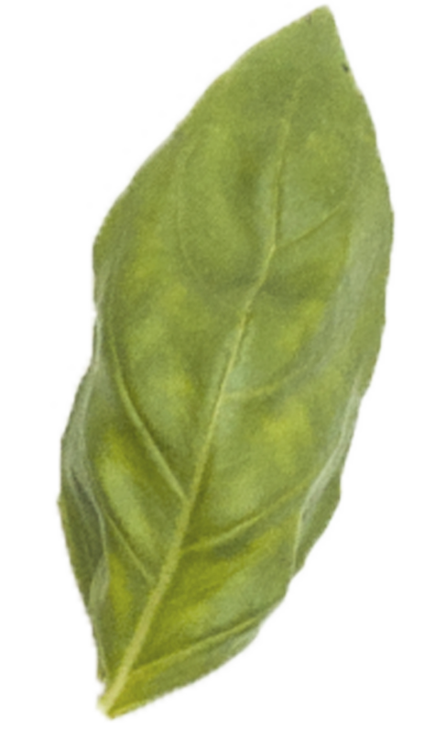
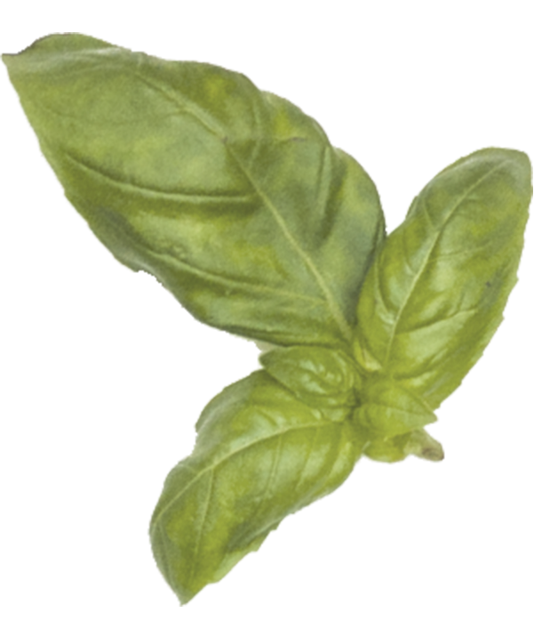
GITHUB LINK: https://github.com/Mruunali/-Seasonal-Agriculture-Performance-Analysis

Slide 23

VOIS Course completion certificate - Data Visualization

Slide 24
Thanks!

